Slide 1
Disruptive Art
STAGE 6 CASE STUDY

Slide 2
What is Disruptive Art?
What might it involve? Can you think of any disruptive artists?

Slide 3
Disruptive:
causing or tending to cause disruption
synonyms:
troublesome
unruly
badly behaved
rowdy
disorderly
undisciplined
Wild
Provocative
Antagonistic
Subversive
.

Slide 4
Key Questions to consider...
What are some examples from previous units of artists or artworks who do this?
What are artworld traditions and conventions?
Why do artists rebel and transgress conventions?

Slide 5
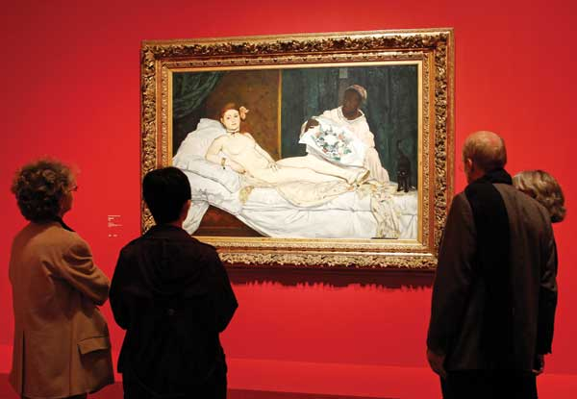

Slide 6
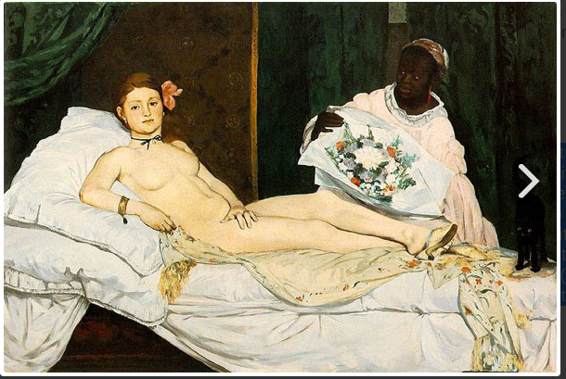
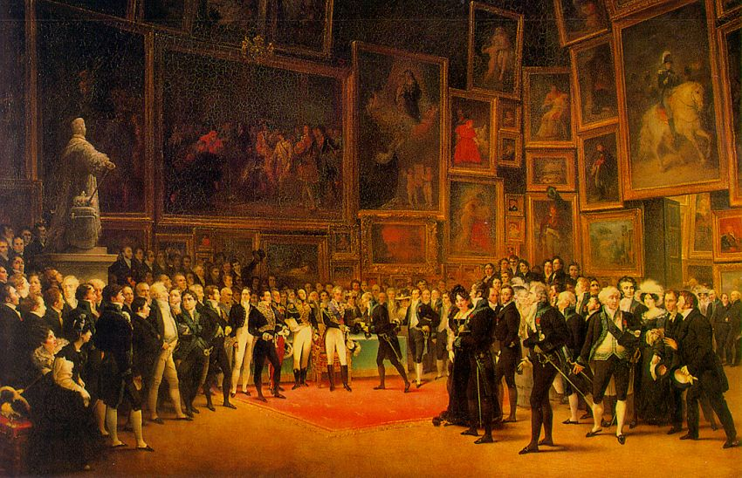
Manet - Olympia (1863)
Representing a lower-class prostitute, Manet's Olympia confronts the bourgeois viewer with a hidden, but well-known, reality.
Purposefully provocative, it shocked the viewers of the 1865 Salon.
Olympia's references to Titan's Venus of Urbino (1538) and Goya's Maja Desnuda (1799-1800) fit easily into the traditional "boudoir" genre, yet they culminate in a rather informal and individual portrait of a woman unashamed of her body.
Oil on canvas - Musee d'Orsay
When Edouard Manet's painting Olympia is hung in the Salon of Paris in 1865, it is met with jeers, laughter, criticism, and disdain. It is attacked by the public, the critics, the newspapers. Guards have to be stationed next to it to protect it, until it is moved to a spot high above a doorway, out of reach.

Slide 7
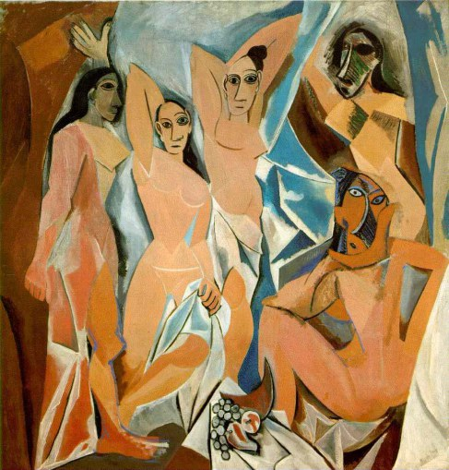
Picasso - Les Demoiselles D’Avignon, 1907
Les Demoiselles D’Avignon: Depicting five prostitutes in a disconcerting manner surrounded by a savage aura of primitivism, Picasso’s infamous painting evoked controversial anger from the public and critics alike. People found the painting grotesque in its painterly flatness, geometric deconstruction of the figure, and in the unflattering manner in which the women were portrayed.
Pablo Picasso, Les Demoiselles D’Avignon, 1907, oil on canvas

Slide 8
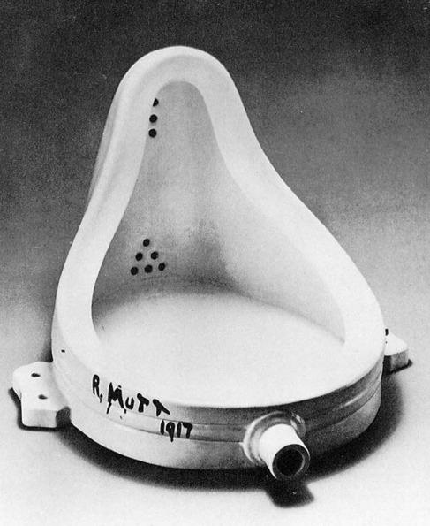
Marcel Duchamp - Fountain, 1917
Fountain: One of the first examples of artist censorship, this scandalous artwork by Duchamp consisting of a porcelain urinal was quickly rejected for exhibition by the Society of Independent Artists in 1917. The kicker here is that this exhibition claimed to accept all artworks by those who paid the fee; Duchamp paid the fee, but was denied under the terms of the work’s “indecency.”
Marcel Duchamp, Fountain, 1917, ceramic
CONSIDER: This artwork is nearly 100 years old! And people still find it disruptive and shocking.

Slide 9
A century ago, with Science and the humanities coming of age, one would have expected rationality to finally sink in. But major parts of the works that form the corpus of Modernism are again testimony of the opposite. Duchamp's iconoclastic gesture of the readymade would become the benchmark against which the capacity of all future art to transgress societal and artistic conventions is assessed. His readymade sculpture The Fountain (1917) has been variously described as Surrealist and Dadaist. Of course, the transgressive gesture was at the core of Surrealism as well as Dadaism. And The Fountain would change forever the attitude in which the transgressive art is made. Magritte made the impertinent gesture of confounding our perceptions with his painting This is Not a Pipe (1928-29) as easily as he made and sold in a terrifying gesture of impudence forgeries of Picassos, Braques, Chiricos and even banknotes. With Duchamp and Magritte, the transgressive gesture is unburdened of somberness and acquires an attitude of irreverence. This attitude, in its various avatars, exists in art since then.
- See more at: http://www.artnewsnviews.com/view-article.php?article=transgressive-art-as-a-form-of-protest&iid=32&articleid=938#sthash.K191FFeT.dpuf

Slide 10
Postmodern Frame + Conceptual Framework Matrix
STAGE 6 VISUAL ARTS SUPPORT DOC- BOSTES

Slide 11
Disruptive Art
KEY WORDS:
Challenge
Subvert
Overthrow
Conventions
Disrupt
Transgress
Art has been historically engaged in a cycle of renewal, with the agreeing and subsequent breaking of conventions eg. Impressionism > Expressionism / Cubism > Surrealism
Art that is ‘disruptive’ is concerned with the practice of artists who actively seek to challenge, subvert or overthrow canonical art principles and/or audience values.
There is an emphasis on challenging artworld traditions and audience beliefs
Canon of art history:
The conventional timeline of artists who are sometimes considered as ‘Old Masters’ or ‘Great Artists’. Today’s art history attempts to question these rules of ‘greatness’, considering issues of gender, race, class, and geography among others.

Slide 12
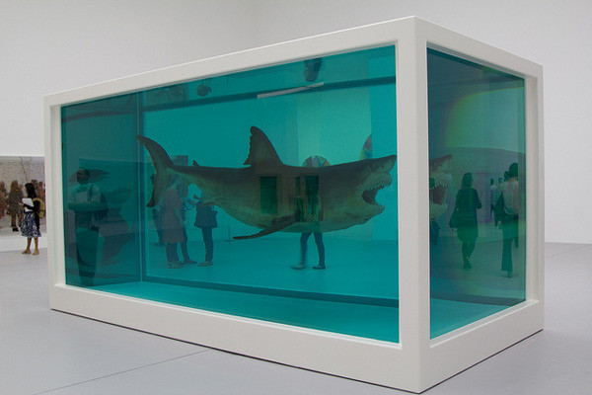
What function does disruptive art serve?
Break/transgress taboos
Challenge/violate audiences beliefs, values, morals
Ask tough questions
Break rules, conventions, traditions of art practices and history
Taboo: a social or religious custom prohibiting or forbidding discussion of a particular practice or forbidding association with a particular person, place, or thing
Damien Hirst, The Physical Impossibility of Death in the Mind of Someone Living, 1991

Slide 13
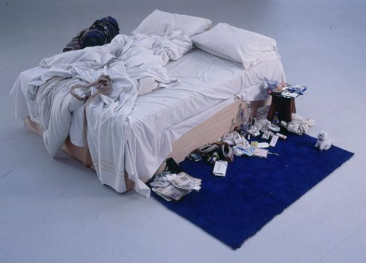
DISRUPTIVE ART
Transgressive art has the capacity to put our values those we hold as a nation or as a culture to the test.
It works by confounding our interpretation and our judgment.
When the beliefs we hold so dear are challenged, we are vulnerable to being offended.
Yet, art that offends our value judgment should be engaged with sincerely as it exposes us to the shaky ground on which our values are so often based
Much radical art takes the liberty of transgressing the boundaries and protocols of certain societal categories like religion, sexuality, gender, body and finally art history itself.
Tracey Emin, My Bed, 1998

Slide 14
Oscar Wilde, speaking for transgressive art, proposed that 'the critic should be able to recognize that the sphere of art and the sphere of ethics are absolutely distinct and separate.'

Slide 15
How do rebellious artists violate art rules?

Slide 16
MICHAEL LANDY
In the ‘No frills’ series art is reduced to self-descriptive consumer units recalling the most literal conceptual art practices. The works are as obvious as they appear; there is no more to them than what you see. But of course they also suggest the contested terrain of marketing-fed consumer desire versus consumer rights for low-cost alternatives to branded products. Within the context of the art market this series is a deeply ironic swipe at what the art-world values and why, and the artist as a brand.
Print
2007
Michael Landy
England
1963 -

Slide 17
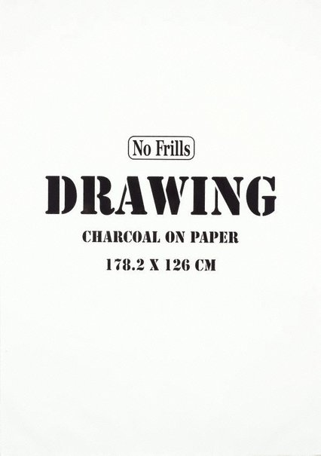
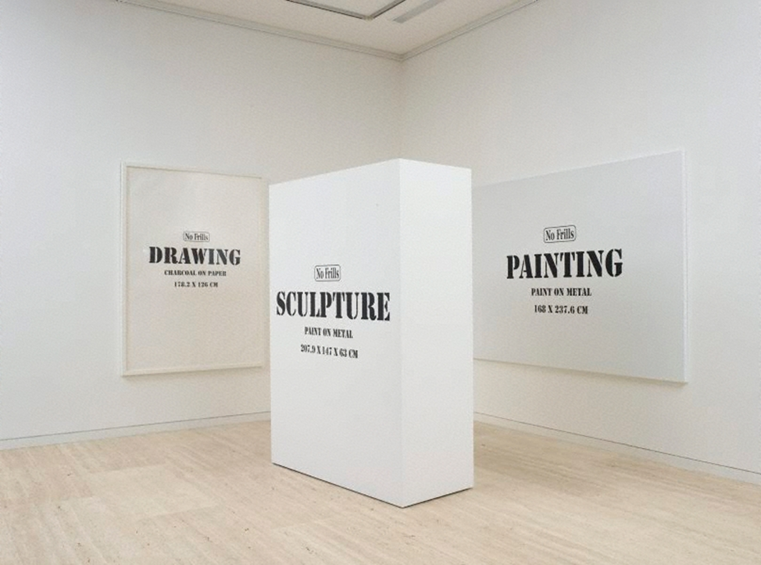
Painting (1)
2007
Drawing (2)
2007
Michael Landy, Sculpture , 2007

Slide 18
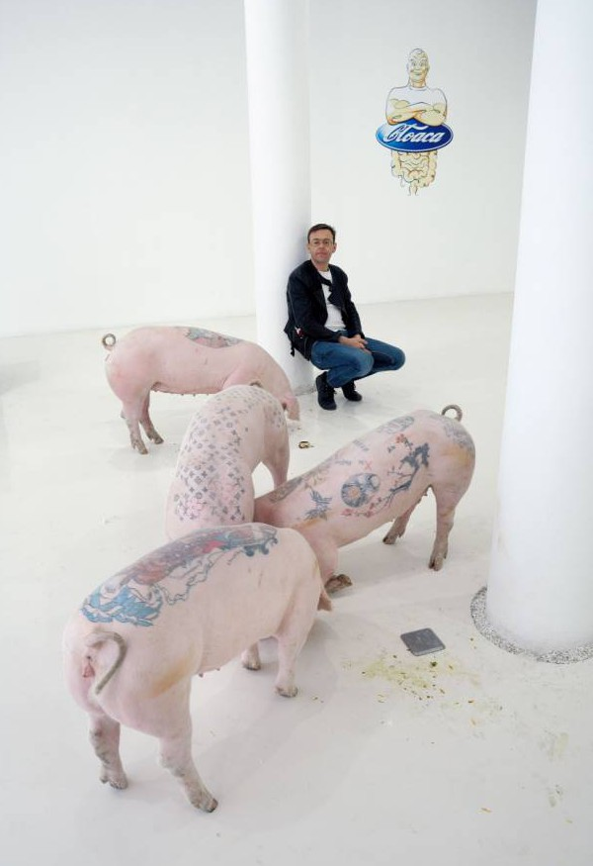
Focus Artist 1:
WIM DELVOYE
Tattooed Pigs
Cloaca

Slide 19
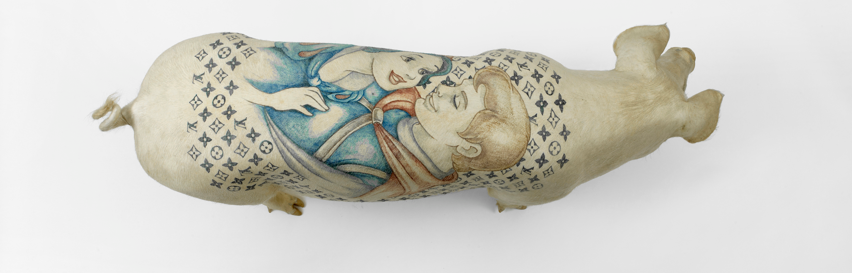
FOCUS ARTIST:
WIM DELVOYE
Wim Delvoye (born 1965 in Wervik, West Flanders)^{[1]} is a Belgian neo-conceptual artist known for his inventive and often shocking projects.
Much of his work is focused on the body. He repeatedly links the attractive with the repulsive, creating work that holds within it inherent contradictions- one does not know whether to stare, be seduced, or to look away.

Slide 20
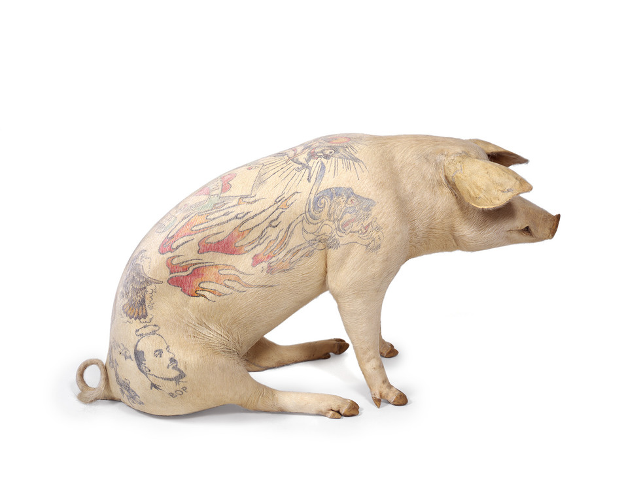
WIM DELVOYE
As Robert Enright wrote in Border Crossings, "Delvoye is involved in a way of making art that reorients our understanding of how beauty can be created".^{[2]}
Wim Delvoye has an eclectic oeuvre, exposing his interest in a range of themes, from bodily function, to the Catholic Church, and numerous subjects in between.
He lives and works in Belgium, but recently moved to China after a court of law judged his pig tattoo art projects illegal.
Jamie, 2005
Tattooed pig skin on polyester mold
145 x 75 x48cm

Slide 21
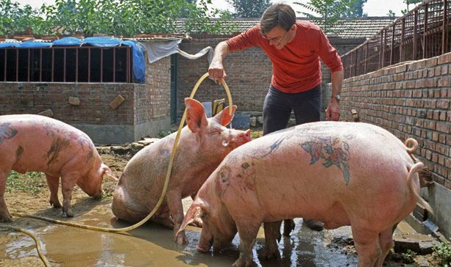
Delvoye started tattooing the skin of dead pigs in the early 1990s, but it was not until 1997 that the artist began to use live pigs as a canvas.
In 2004, he bought a farm in a little village near Beijing where he systematically elaborated the artistic concept for his Art Farm. There, the pigs grow up while a team of specialists looks after them.
Assistants, veterinarians, and, of course, Delvoye himself, sedate the piglets, shave their skin, tattoo them, keep the wounds clean and their skin properly moisturised.
In an interview with the French newspaper Le Monde,Delvoye described his concept as follows: ‘I show the world works of art that are so alive, they have to be vaccinated…It lives, it moves, it will die. Everything is real.’

Slide 22
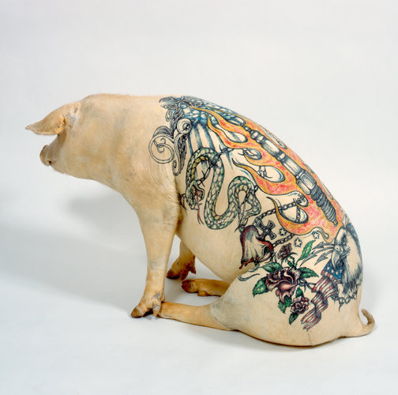
The tattoos themselves are based on Delavoye’s drawings, most of which refer to Western iconography.
From popular biker symbols such as hearts and skulls, to Disney princesses, the Louis Vuitton monogram and religious images, Delvoye ‘mixes antagonist elements in order to create an impact and make people feel uncomfortable.’
By placing the motifs on pigskin, the artist takes away their message and purpose. They become pure decorum, their only intent is to shock and be beautiful.

Slide 24
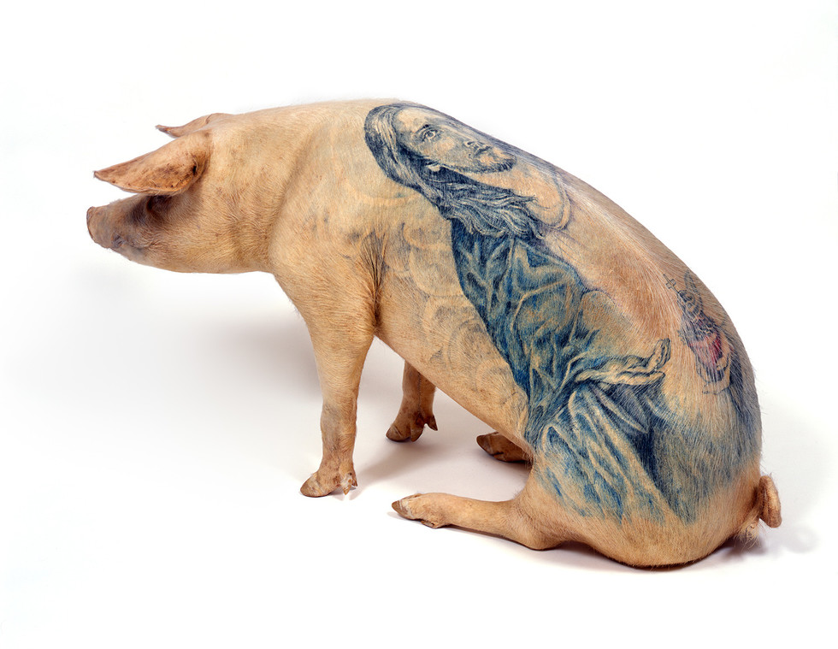
All works from: https://www.wimdelvoye.be/work/art-farm/
Jesus, 2005
Tattooed Pig Skin on Polyester Mould 47x25x75cm

Slide 25
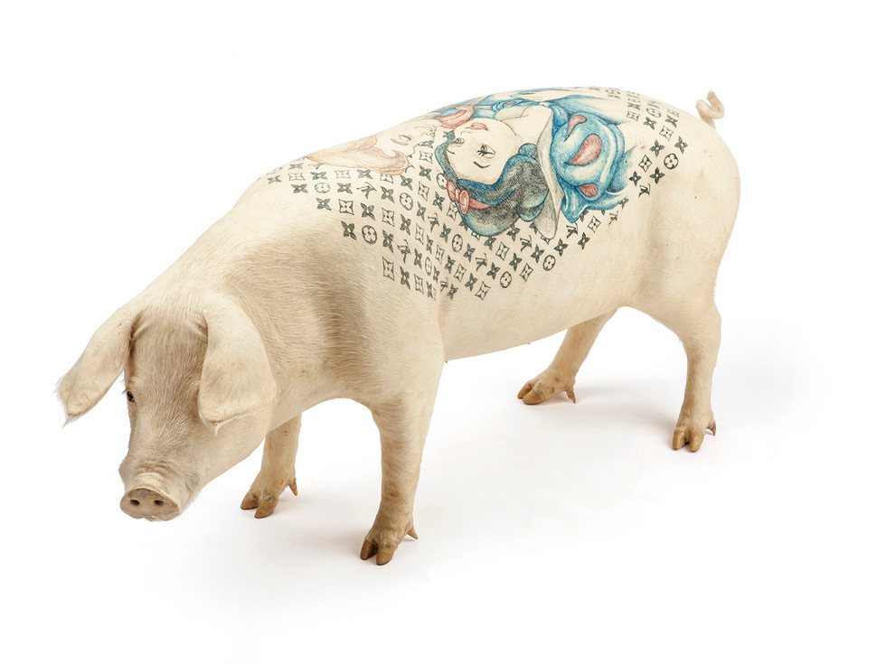
‘When visitors turn around the pigs, observe it, I am happy. I feel like I‘ve given them back their dignity’.
Snowwhite, 2005
Tattooed pig skin on polyester mould 67x30x140cm

Slide 26
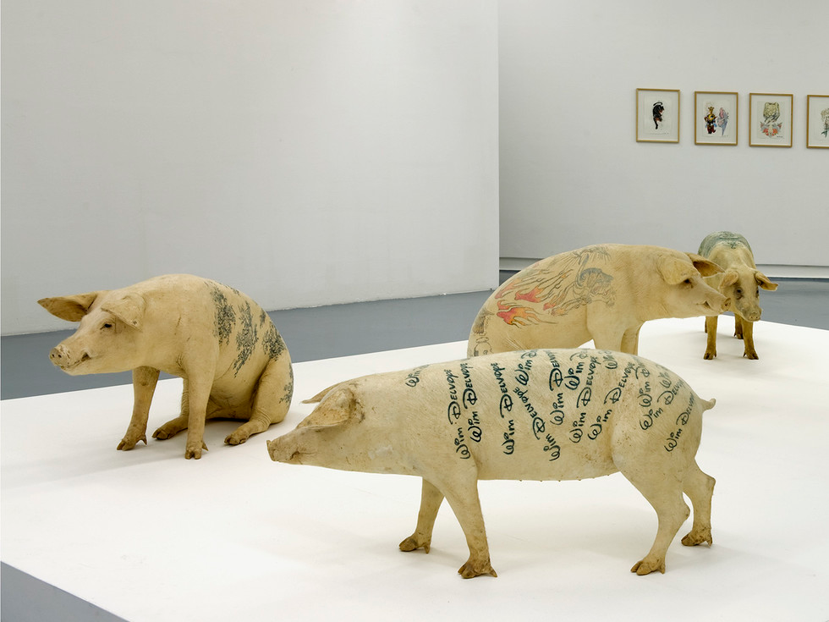
Stuffed carpet pigs, 2010
tattooed pig skin on polyester mould - variable dimensions
Installed at MAMAC, Nice

Slide 27
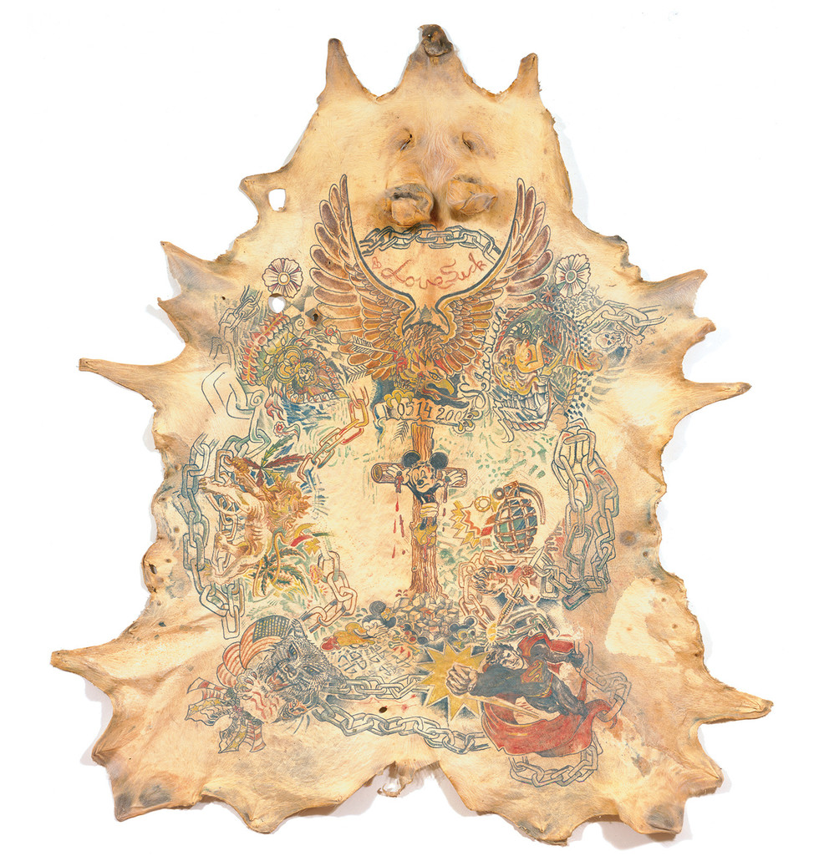
Untitled (Lovesick Sebastian),
2001
Tattooed pig skin
133x120cm
DETAIL

Slide 28
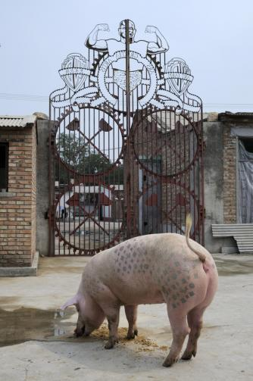
The artist sees the pig as an investment, a piggy bank, literally.
Sporting Louis Vuitton logos and Disney princesses, Delvoye’s live pigs were tattooed as piglets and grew along with their marks.
art collectors could choose to buy either live tattooed pigs or taxidermied dead ones. Buyers can purchase a pig and let it grow old on the farm. After its death, they can ‘harvest’ the skin. The pigs are not killed for their skin, but they live in order to produce the live canvas that is their skin.
They are live objects of consumption as soon as the ink decorates their backs, but they can only be materially possessed after their death.
Delvoye imitates the concept of economic growth by assigning a ‘value’ to the pigs. The ink drawings on their backs enlarge as the pigs grow bigger, and as their shapes change, so do their tattoos.

Slide 29
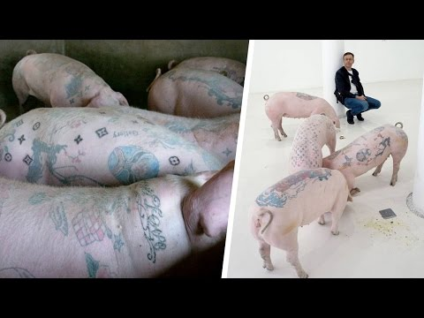
A SEGMENT FROM THE YOUNG TURKS DISCUSSING TATTOOED PIGS

Slide 30
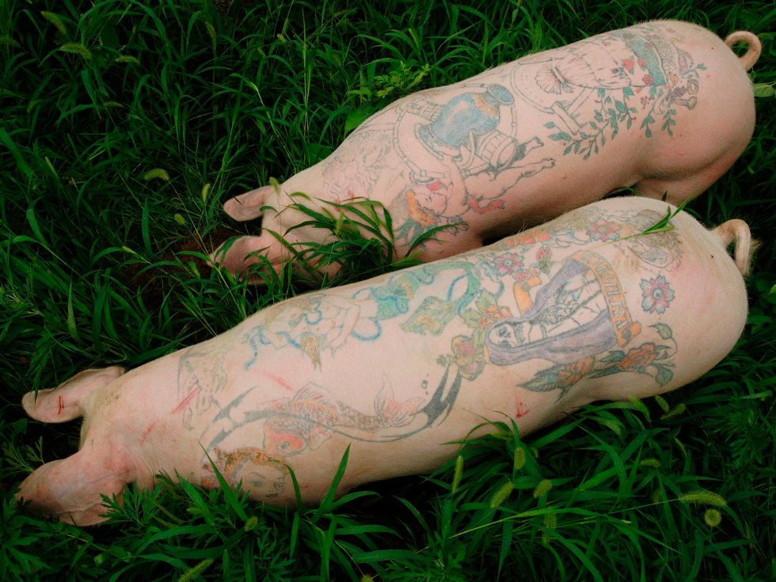
Art Farm
2003-2010
live tattooed pigs
Yang Zhen, Beijing

Slide 31
DISCUSSION
Wim Delvoye
TATTOOED PIGS
What do you think about Tattooed Pigs?
In what ways does the artwork cause controversy?
What issues does the artist explore in his work?
How are art traditions subverted and disrupted in Tattooed Pigs?
What is the role of the audience in relation to Tattooed Pigs?

Slide 32
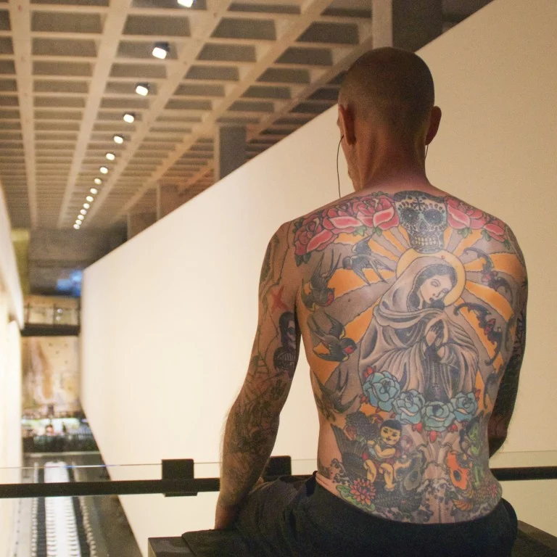
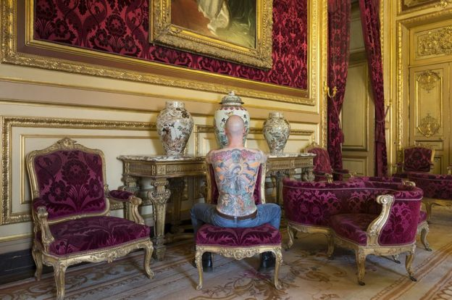
TIM
Tim Steiner has an elaborate tattoo on his back that was designed by Wim Delvoye and sold to a German art collector. When Steiner dies his skin will be framed - until then he spends his life sitting in galleries with his shirt off.
"The work of art is on my back, I'm just the guy carrying it around," says the 40-year-old former tattoo parlour manager from Zurich.
A decade ago, his then girlfriend met a Belgian artist called Wim Delvoye, who'd become well known for his controversial work tattooing pigs.
Delvoye told her he was looking for someone to agree to be a human canvas for a new work and asked if she knew anyone who might be interested.
"She called me on the phone, and I said spontaneously, 'I'd like to do that,'" Steiner says.
Tim at MONA 2019
https://www.bbc.com/news/magazine-38601603
Tim at the Louvre in 2012

Slide 33
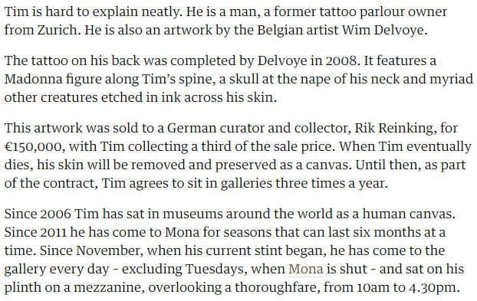
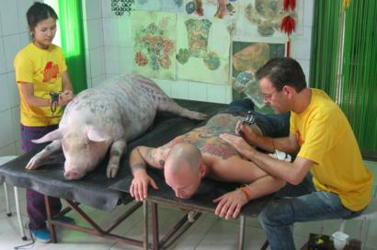
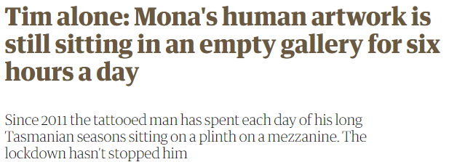
Tim
https://www.theguardian.com/artanddesign/2020/apr/22/tim-alone-monas-human-artwork-is-still-sitting-in-an-empty-gallery-for-six-hours-a-day

Slide 34
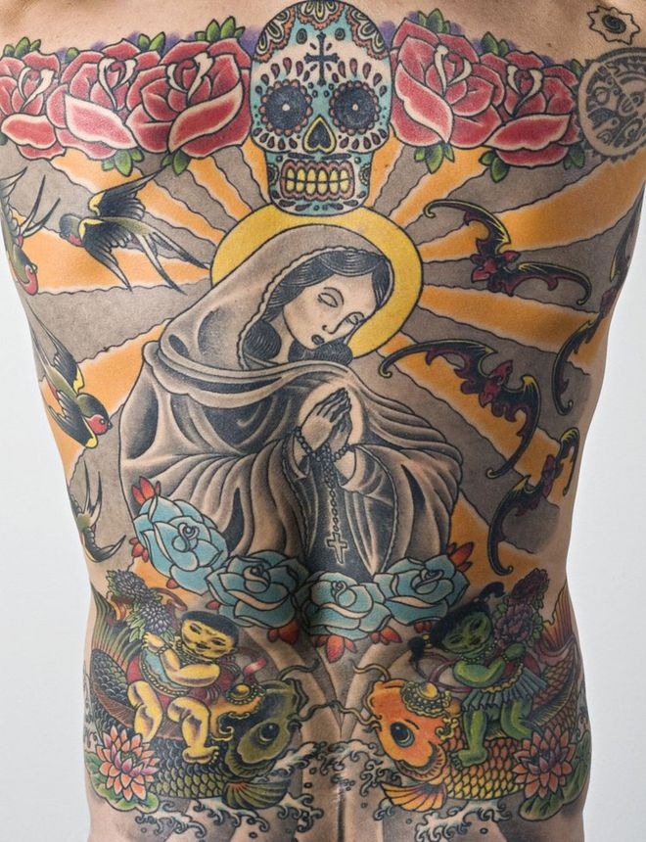
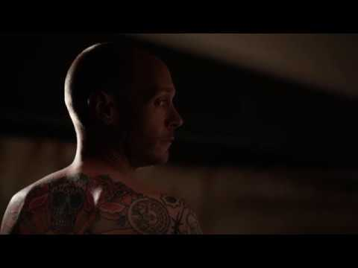
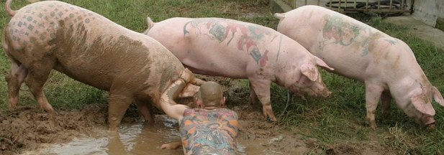
As part of the deal, when Steiner dies his back is to be skinned, and the skin framed permanently, taking up a place in Reinking's personal art collection.
"Gruesome is relative," Steiner says to those who find the idea macabre.
"It's an old concept - in Japanese tattoo history it's been done many, many times. If it's framed nicely and looks good, I think it's not such a bad idea."
https://www.bbc.com/news/magazine-38601603

Slide 35
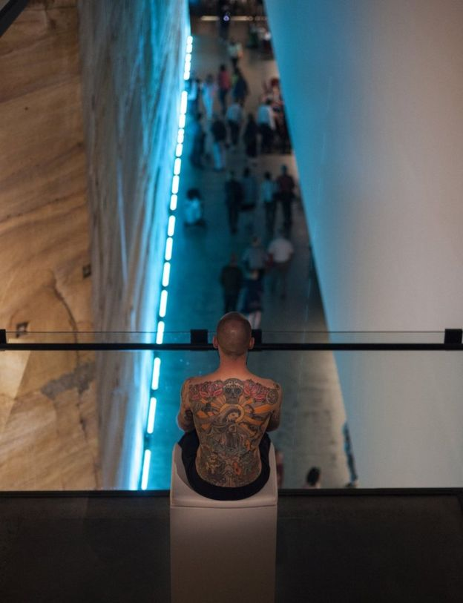
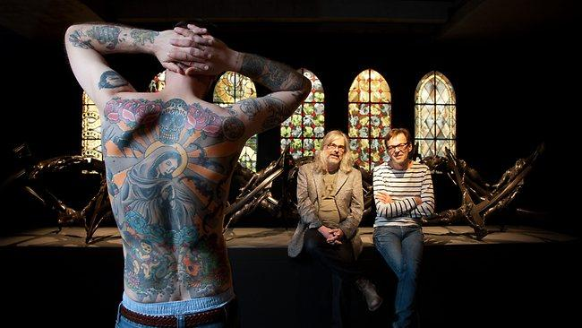
"It becomes a huge discussion matter every time, and those confrontations with people have been very exciting and interesting," Steiner says.
"People are either very into the idea, or say it's going too far - they're outraged or say it's against human rights. They come with ideas of slavery or prostitution."

Slide 36
DISCUSSION
Wim Delvoye
TIM
What do you think about Tim?
In what ways does the artwork cause controversy?
What issues does the artist explore in his work?
How are art traditions subverted and disrupted in Tim?
What is the role of the audience in relation to Tim?

Slide 37
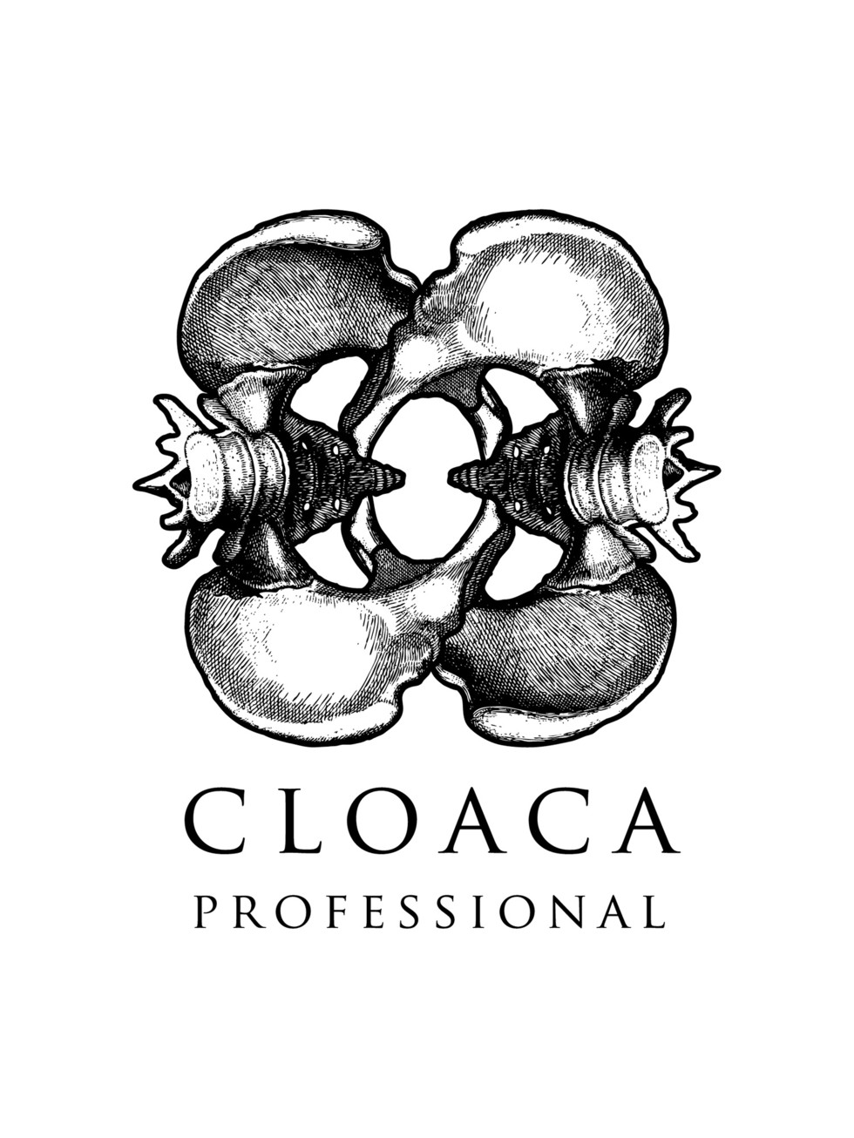
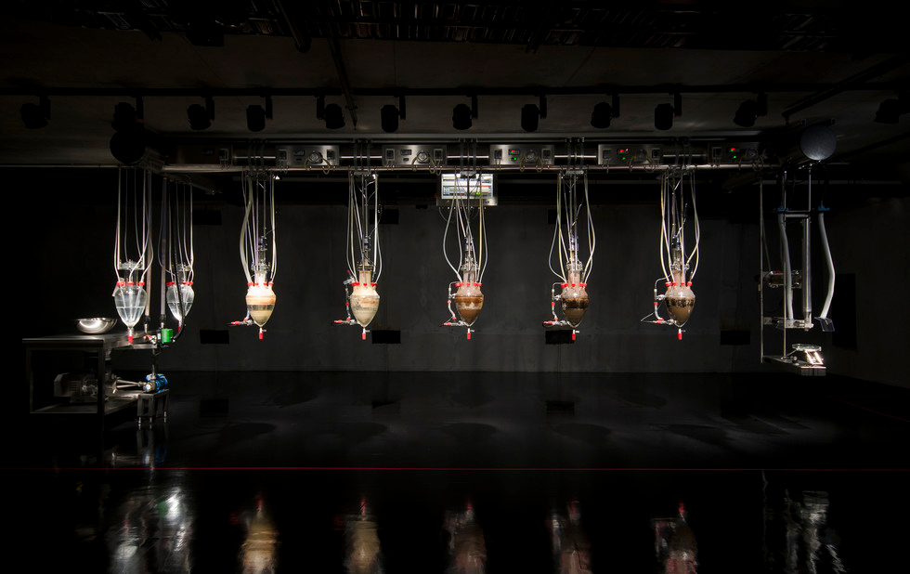
The installation "Cloaca Professional, 2010" by Belgium artist Wim Delvoye, which has been dubbed the "poo-machine" is shown on display at the Museum of Old and New Art (MONA) in Hobart, Australia.

Slide 38
CLOACA PROFESSIONAL
The most talked-about piece at Tasmana’s MONA is the Cloaca Professional, labeled the "poo-machine." It was built by Belgian artist Wim Delvoye to mimic the actions of the human digestive system.
A series of glass receptacles hang in a row with the machine being "fed" twice a day on one end. The food is ground up "naturally," the way it is in the human body, and the device produces feces on the clock at 2 p.m. at the other end.
The smell is so powerful that not many visitors can take it.
"It put me off because of the overwhelming assault on the senses," said Diane Malnic, a Sydney-based accountant.
The Cloaca is part of a series of at least five similar machines built by the artist, another of which will soon be exhibited at the Louvre. It is the most hated piece in the museum but also the most visited.

Slide 39
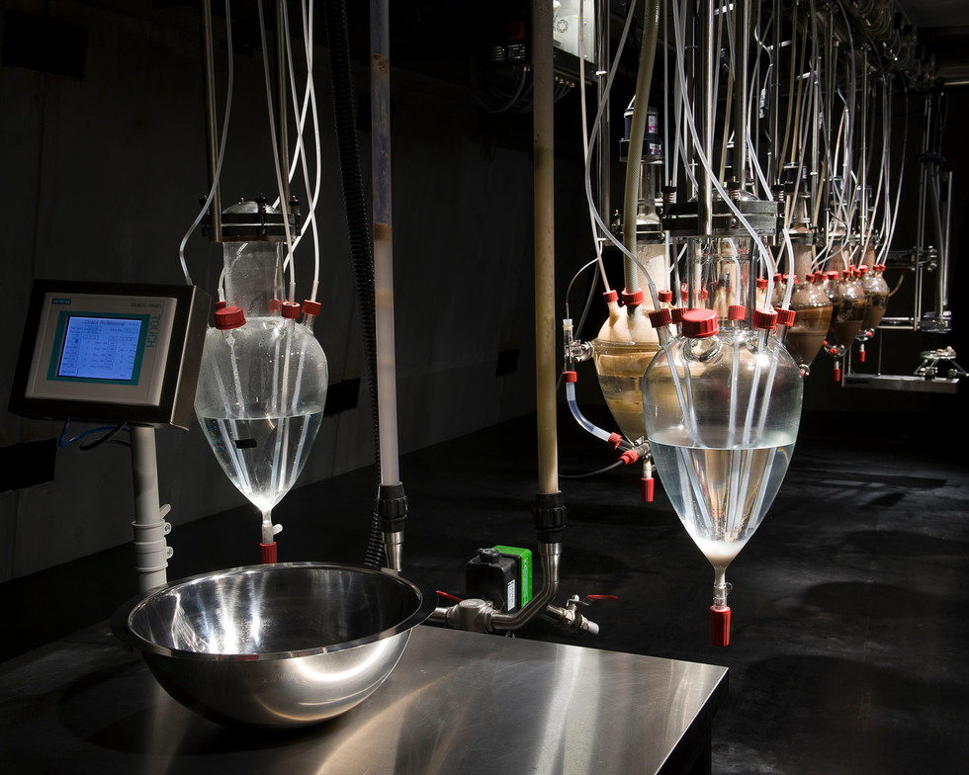
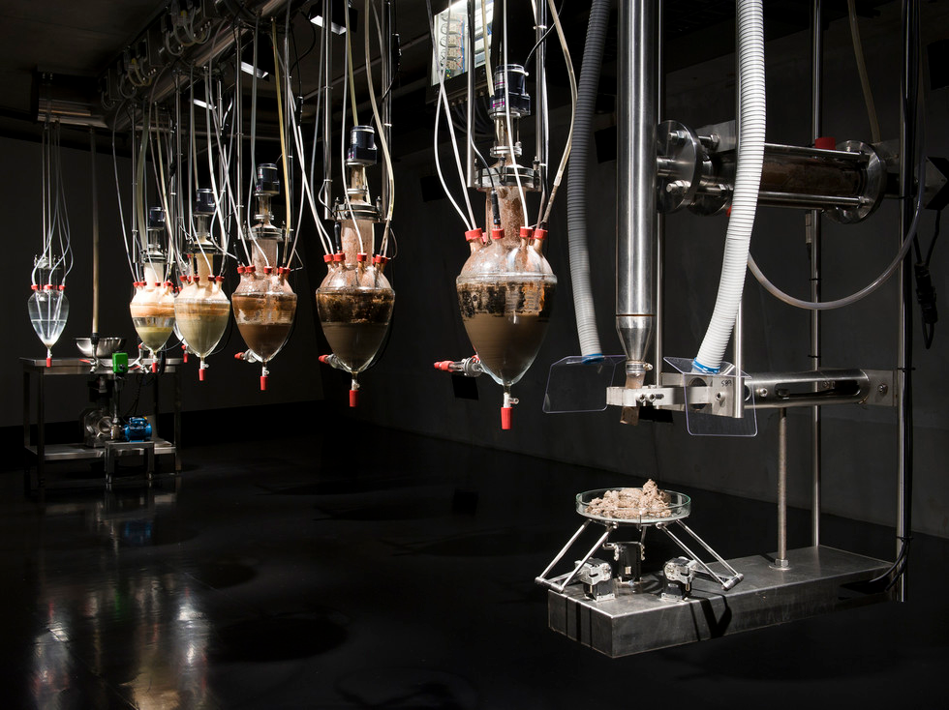
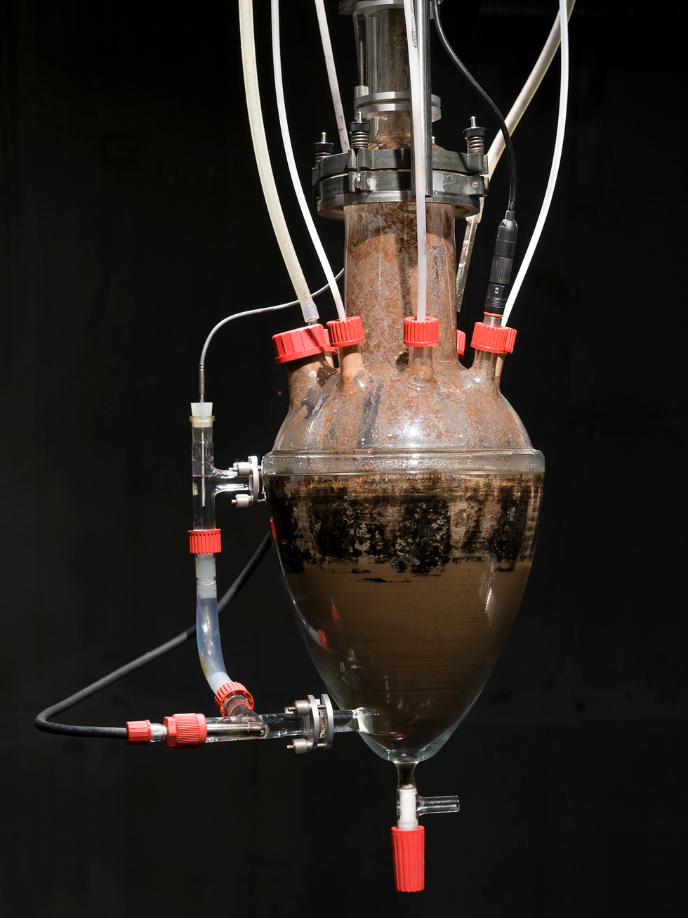
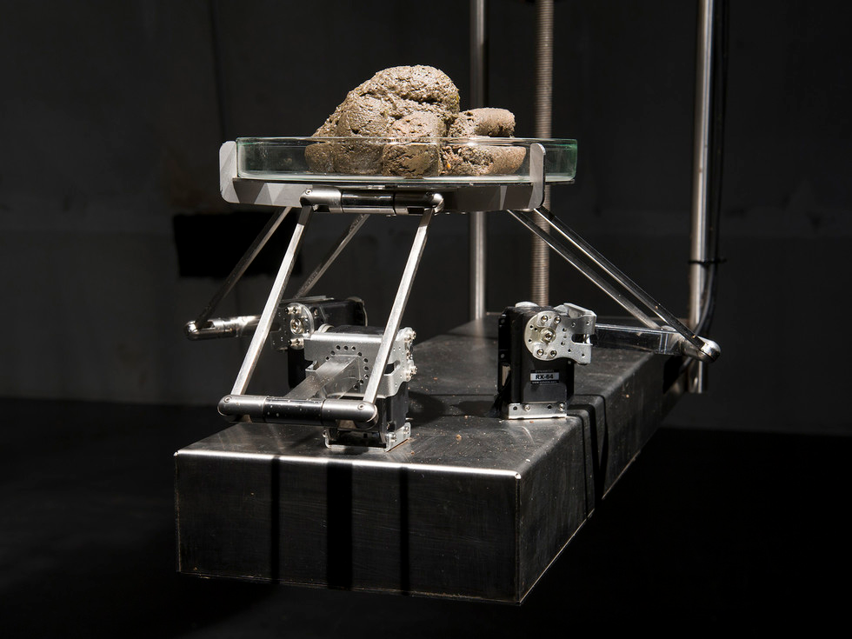

Slide 40
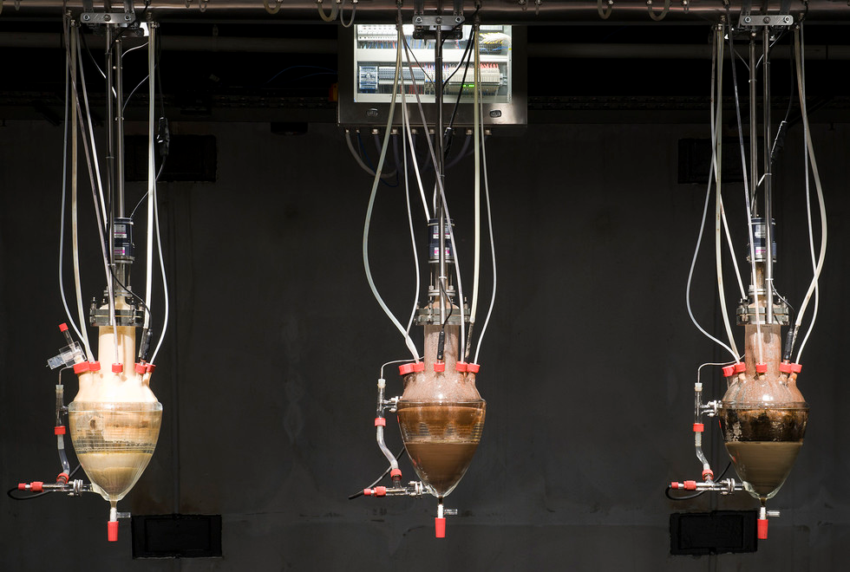

Slide 41
https://www.arte.tv/en/videos/065483-004-A/art-scandals-4-9/

Slide 42
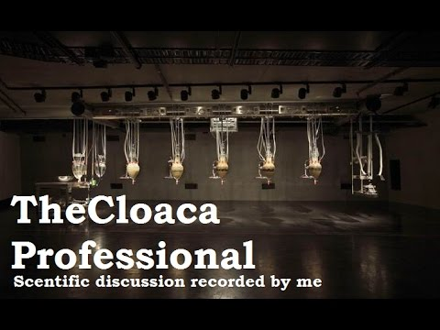

Slide 43
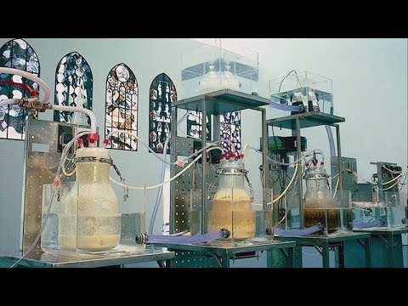
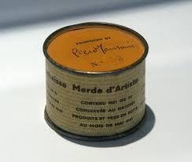
Artist's Sh*t (Italian: Merda d'artista) is a 1961 artwork by the Italian artist Piero Manzoni. The work consists of 90 tin cans, each reportedly filled with 30 grams (1.1 oz) of faeces, and measuring 4.8 by 6.5 centimetres (1.9 in × 2.6 in), with a label in Italian, English, French, and German stating:
Artist's Sh*t
Contents 30 gr net
Freshly preserved
Produced and tinned
in May 1961
Delvoye feels that the things Italian artist Piero Manzoni (b.1933-d.1963) has done have not only been an inspiration but also a legitimation for the Belgian artist

Slide 44
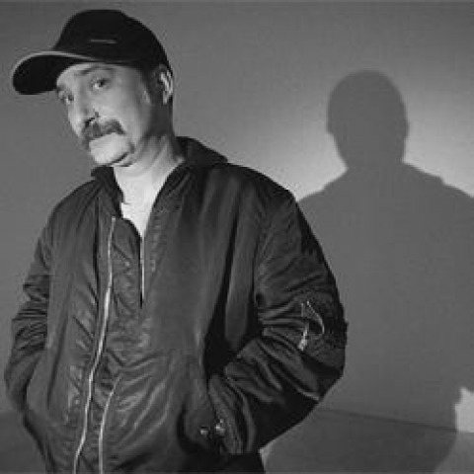
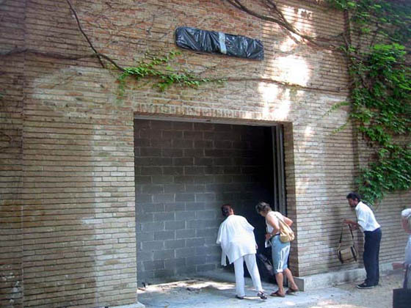
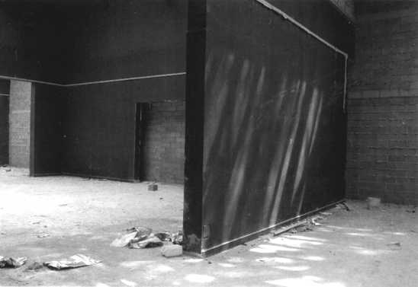
Santiago Sierra
Born in Spain in 1966, Santiago Sierra was has lived and worked in Mexico City since 1995.
In 2003 he came to the attention of a broad audience overnight with his “closure” of the Spanish Pavilion at the 50th Venice biennial. Having walled up the entrance to the pavilion with bricks, he stationed a Spanish police officer at the site allowing access via a dingy side entrance only to those who could produce a valid Spanish passport. The few who were allowed inside were confronted with nothing but empty rooms. The actual event took place in total secrecy and was documented by only one photograph.
Viewing Santiago Sierra’s Wall Enclosing a Space, Spanish pavilion, Venice Biennial, Venice Italy, 2003

Slide 45
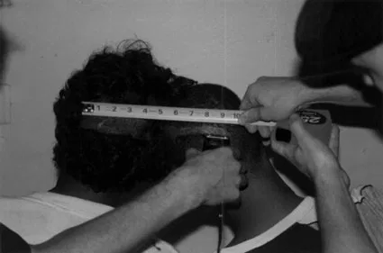
This work forms part of a highly provocative series by Sierra that explores the economic and social structures within capitalist societies. The artist paid two heroin addicts from a disadvantaged neighbourhood in Puerto Rico to take part in an artwork by each having a section of their head shaved, while the event was filmed and photographed. For other works, Sierra has hired a homeless man to clean shoes at an art opening, paid a group of people to have a line tattooed across their backs, and hired Iraqi immigrants to be sprayed with polyurethane foam to create a sculpture.
Deliberately controversial, Sierra’s art examines the impact of capitalism on those on the margins of society, such as immigrants, drug addicts, and manual labourers. Usually invisible to those in power, they are brought into the spotlight in his work in challenging style, presented as objects to entertain—and outrage—art audiences.
10 INCH LINE SHAVED ON THE HEADS OF TWO JUNKIES WHO RECEIVED A SHOT OF HEROIN AS PAYMENT,
Santiago Sierra, 2000. (Duration 5:00 minutes)
https://www.artspace.com/magazine/art_101/book_report/phaidon-most-controversial-21st-century-53544

Slide 46
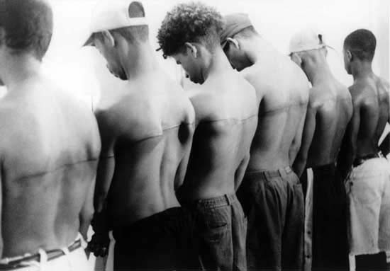
SANTIAGO SIERRA
Santiago Sierra’s work addresses some of the most pressing issues of our time.
His controversial video work and installations highlight some of the often ignored problems inherent to a globalised capitalist economy.
Sierra’s work normally takes the form of ephemeral actions or temporary interventions. While adopting a minimal language, he creates ‘incidents’ that highlight the existence of situations of conflict.
Many of Sierra’s more recent projects have been the outcome of a particular social context, exposing the reality of that environment.
Santiago Sierra
8-Foot Line Tattooed on Six Remunerated People
1999
Black and white photograph

Slide 47
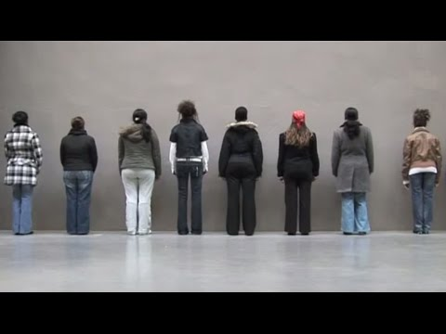

Slide 48
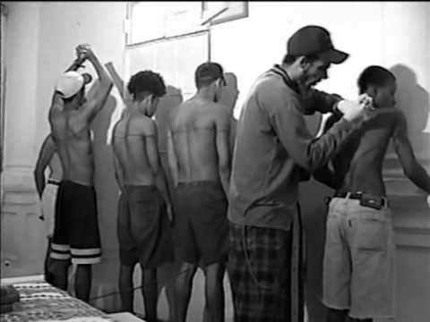
Santiago Sierra creates performative works that rely on participation between artist, the subjects of the works and the audience.
Through these works he accentuates the identity of participants who are representative of social groups different to normative, affluent art audiences.
Sierra hires disadvantaged, marginalized individuals to perform meaningless tasks as live performance in galleries
Santiago Sierra initiates actions that refer to everyday social life.
By intervening directly in life, his work reveals political developments and social dynamics and shows how, with minimal intervention, systems and their ordered structures can be undermined.
His socio- and art-critical actions and interactions stir up strong emotions in an audience that has grown accustomed to aesthetic appearances.
Santiago Sierra
8-Foot Line Tattooed on Six Remunerated People
1999
Still from video
Link to video of 8-Foot Line Tattooed on Six Remunerated People
https://www.youtube.com/watch?v=fnfdLT21Xd8

Slide 49
In an interview with Stuart Jeffries Sierra was asked why his employees never rebelled against their exploitation and he responded
‘It amazes me that people don’t attack me or, very often, the works. I do get annoyed when we speak of these people as “them”. Artists are no better. Joseph Beuys once claimed that there was clean money and dirty money. We should only take the former. I don’t believe that: there’s only dirty money. And as an artist I take dirty money. I’m paid to create luxury goods for art collectors.’

Slide 50
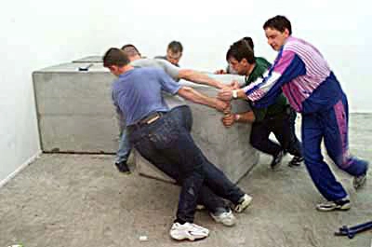
Sierra’s tactics are relatively unique. His most effective method to date has been to find unemployed casual labourers who are prepared to do virtually anything for minimum wage. Once hired they are assigned by Sierra to especially meaningless and demeaning activities.
What follows is a list of such activities:
1.He paid drug-addicted prostitutes to have their backs tattooed for the price of a shot of heroin.
2.He hired 200 immigrants of African, Asian and eastern European origin, all of whom had dark hair, for an ‘action’ in which their hair was bleached.
3.He hired a group of unemployed men to push concrete blocks from one end of a gallery to the other.
4. In an exhibition at P.S.1, New York, Person Remunerated for a Period of 360 Consecutive Hours Sierra hired a person to live behind a brick wall 24 hours a day for 15 days (September 17 – October 1, 2000) without having any further instructions or duties. Staff slid food under a narrow opening at the base of the wall. The individual behind the wall was generally invisible to the audience but was allowed to relate to the other side through the small opening in the wall.
Santiago Sierra, 700 cm of displacement for three blocks of 100 cm per side. Six people are hired to push one cubic metre blocks 700 cm. Courtesy Galerie Peter Kilchmann, Zürich.

Slide 51
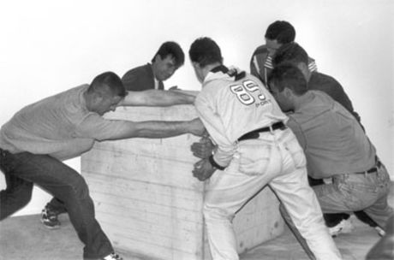
As the title implies, Sierra paid migrant workers a daily wage to constantly move 24 blocks of concrete around a gallery space. The audience were presented with the final position of the 24 blocks, the scratches on the gallery floor, the tools the workers used and the remnants of food packaging. This piece addresses, amongst other things, Marxist interpretations of the exchange value of labour, which argued that the workers’ labour time is worth less to the capitalist than its subsequent exchange value in the form of a commodity produced by this labour.
The fact that the migrant workers were remunerated with an amount equivalent to the low wage they could expect to receive for their labour outside the gallery space is critical to the piece’s narrative. Everything has a price, the labour of the migrant, virtually worthless, the value of the commodity as art piece substantially more, both to the gallery and Sierra himself. The viewer is also presented with the uncomfortable reality of the underbelly of the society we all inhabit. By engaging with the piece, the viewer is also knowingly complicit in the exploitation that has occurred.
Santiago Sierra, 700 cm of displacement for three blocks of 100 cm per side. Six people are hired to push one cubic metre blocks 700 cm. Courtesy Galerie Peter Kilchmann, Zürich.
Link to video of 700 cm of displacement for three blocks of 100 cm per side. Six people are hired to push one cubic metre blocks 700 cm.
https://www.youtube.com/watch?v=erj_QZ8GiNA

Slide 52
8-Foot Line Tattooed on Six Remunerated People
In Santiago Sierra's 8-Foot Line Tattooed on Six Remunerated People (1999), an eight-foot line literally runs vertically across the length of the upper backs of five shirtless males. A jarring piece, the work's impact is heightened by the fact that each of the subjects depicted in Sierra's large grainy photograph were paid a princely sum of $30 to have the tattoo etched onto their skin.
Santiago Sierra
8-Foot Line Tattooed on Six Remunerated People
1999
Black and white photograph

Slide 53
The art system (galleries, institutions, free market) will transform any mode of production into precious objects.
In the case of Sierra’s work such objects would include limited edition photographs of his actions.
A specific instance of such an object is a photograph of his action where an eight foot line (2.44 metre) was tattooed on the backs of eight remunerated people.
The photograph becomes the precious object and the person who exhibits it—like the person who buys Benetton—buys something more than an art photograph, they buy a chic species of ethical credibility. They also buy a conversation piece. In contrast, the people who took part in the work however remain marked for life by their subjugation to High Art.
https://tiffobenii.wordpress.com/participation/santiago-sierra/
Santiago Sierra
8-Foot Line Tattooed on Six Remunerated People
1999
Black and white photograph

Slide 54
In his work Santiago Sierra often addresses structures of power that operate in our everyday existence.
Sierra's work intervenes into these structures exposing situations of exploitation and marginalisation, famously hiring underprivileged individuals who, in exchange for money, are willing to undertake pointless or unpleasant tasks.
Sierra's work never repeats reality, but challenges it exposing its intrinsic mechanisms.
The essence of the work is often in the tension generated between the event or its documentation and the audience.
KEY WORDS Intervenes Exploitation
Marginalisation Expose

Slide 55
Santiago Sierra
POLYURETHANE SPRAYED ON THE BACKS OF 10 WORKERS, 2004
Lisson Gallery, London, July 2004
Single screen black & white DVD projection (Running time 66 mins and 08 secs.)
variable
https://www.theguardian.com/culture/2004/jul/13/1

Slide 56
This image of a prisoner, Ali Shallal al-Qaisi, being tortured has become internationally famous, eventually making it onto the cover of The Economist
Abu Ghraib torture and prisoner abuse context
Sergeant Ivan Frederick sitting on an Iraqi detainee between two stretchers
Lynndie England holding a leash attached to a prisoner, known to the guards as "Gus"
Lynndie England pulls a leash attached to the neck of a prisoner, who is forced to crawl on the floor, while Megan Ambuhl watches.
A bound prisoner is scared using a dog by a US military officer
https://en.wikipedia.org/wiki/Abu_Ghraib_torture_and_prisoner_abuse

Slide 57
Philip Zimbardo Stanford Prison Experiment
Stanley Milgram's Obedience to Authority

Slide 59
133 Persons Paid to Have their Hair Dyed Blond
2001, Arsenal, Venice, Italy
In the city of Venice there are a great number of illegal street vendors, most of them immigrants from different parts of the world: Senegalese, Bangladeshi, Chinese, and also Southern Italians. They were asked to agree to have their hair dyed blond and were paid 120,000 lire, some $60. The only condition being that their hair be naturally dark. The procedure was done in a collective manner behind the closed doors of a warehouse, situated in the Arsenale, during the opening of that year’s Venice Biennial. Although the number of people originally scheduled to take part in this operation was 200, it was finally reduced to 133 due to the arrival of immigrants in a staggered way, making it difficult to calculate with precision how many people had already entered the hall. It was then decided to shut down the entrance and calculate the number by informal count. This caused numerous problems at the door, due to the never ending flow of people leaving or entering.

Slide 60
For Part II of his exhibition at Lisson Gallery, Santiago Sierra has created two linked ‘actions’ in the gallery entitled “Workers facing the wall” and “Worker facing into a corner”.
Participants in the action have been instructed by Sierra to stand in silence with their heads bowed for one hour a day during the course of the exhibition. As is usual with Sierra’s work, the participants have been recruited locally and are being paid the minimum wage.
Facing the wall has several kinds of associations. It invokes ideas of humiliation, disgrace and punishment. The person facing the wall is vulnerable to attack, to being stabbed in the back, both literally and metaphorically, and also brings to mind prisoners in front of a firing squad.
Standing head bowed and in silence is a submissive stance and potentially uncomfortable, though it remains to be seen whether visitors to the gallery will be equally discomforted by what they experience.
“Workers facing the wall”
People seen from behind is a recurring image in Sierra’s work. In a recent action for the Kunsthalle, Vienna, he recruited people to stand in two lines facing the wall wearing only their underwear. They were then arranged in order of their skin tone.

Slide 61
Jake and Dinos Chapman

Slide 62
The Chapman Brothers
Jake & Dinos Chapman make iconoclastic sculpture, prints and installations that examine, with searing wit and energy, contemporary politics, religion and morality.
Jake Chapman was born in 1966 in Cheltenham, Dinos Chapman in 1962 in London. They have exhibited extensively throughout the world
Jake (b. 1966, Cheltenham) and Dinos (b. 1962, London) Chapman were nominated for The Turner Prize in 2003 and have exhibited their work extensively since the 1990s, including recent solo exhibitions at SongEun ArtSpace Museum, Seoul, and PinchukArtCentre, Kiev, (both 2013); The Hermitage, St Petersburg (2012); and Tate Liverpool (2006).

Slide 63
Working together since their graduation from the Royal College of Art in 1990, the Chapmans first received critical acclaim in 1991 for a diorama sculpture entitled 'Disasters of War' created out of remodelled plastic figurines enacting scenes from Goya's 'Disasters of War' etchings.
Later they took a single scene from the work and meticulously transformed it into a 'Great Deeds Against the Dead' (1994), a life-size tableau of reworked fibreglass mannequins depicting three castrated and mutilated soldiers tied to a tree
GOYA’S ORIGINAL ETCHING
Disasters Of War, however, was commissioned by no one. It was Goya’s private project, which he never even published in his lifetime. Unflinchingly he depicts mutilation, torture, rape and many other atrocities besides – performed, indiscriminately, by French and Spanish alike. This art wasn’t partisan, it was a grim observation of man’s potential inhumanity to man; of the true barbarities of war.
Goya, Disasters of War No.39 (1810-1820)
Great Deeds Against the Dead 1994 Mixed media with plinth 277 x 244 x 152 cm >>>>

Slide 64
INSULT TO INJURY, 2003
Insult to Injury (detail)
2003
Framed: each: 14 9/16 x 18 1/2 in. (37 x 47 cm)
Francisco de Goya 'Disasters of War' Portfolio of eighty etchings reworked and improved
Photo: Stephen White (should this image have a black surround, please crop it out)

Slide 65
“Now the same Chapmans, Jake and Dinos, have taken the art of scandal a step further by altering -- ''rectifying'' was their word -- a set of 80 prints of Goya's ''Disasters of War'' to create a work they call ''Insult to Injury.''
If their aim was to shock, they succeeded. But no, they said, their purpose was more weighty. They were not even expressing dissent over the war in Iraq. Rather, they wanted to proclaim the inadequacy of art as protest.
...But now, thanks to the Chapman brothers, the terrorized victims in ''Disasters of War'' have been given the violet and white faces of clowns and puppies.
...The British art collector Charles Saatchi paid the equivalent of $800,000 for ''Hell'' and, with this money, the brothers bought their own set of ''Disasters of War.''
''We had it sitting around for a couple of years, every so often taking it out and having a look at it,'' Dinos Chapman told The Guardian. Jake added, ''We always had the intention of rectifying it.”
INSULT TO INJURY
Robert Hughes, the art critic and broadcaster, said Goya ''will obviously survive these twerps, whose names will be forgotten a few years from now.''

Slide 66
Chapman Brothers VS Goya
2:20MIN

Slide 67
Arguably their most ambitious work was 'Hell' (1999), an immense tabletop tableau, peopled with over 30,000 remodelled, 2-inch-high figures, many in Nazi uniform and performing egregious acts of cruelty.
The work combined historical, religious and mythic narratives to present an apocalyptic snapshot of the twentieth-century.
Tragically this work was destroyed in the MOMART fire in 2004 and the Chapmans rebuked by saying they would make another, more ambitious in scale and detail
Hell
1999-2000
84 5/8 x 50 11/16 x 98 3/8 in. (215 x 128.7 x 249.8 cm)
Central vitrine: 84 13/16 x 50 3/8 x 50 3/8 in. (215.4 x 128 x 128 cm)
Glass-fibre, plastic and mixed media in nine vitrines
HELL, 1999

Slide 68
Hell
1999-2000
84 5/8 x 50 11/16 x 98 3/8 in. (215 x 128.7 x 249.8 cm)
Central vitrine: 84 13/16 x 50 3/8 x 50 3/8 in. (215.4 x 128 x 128 cm)
Glass-fibre, plastic and mixed media in nine vitrines

Slide 69
In this film, Jake and Dinos Chapman reflect on the 'anti-realism' of their epic installation End of Fun, discussing how their 'hell' could be a universal condition, rather than any specific temporal-historical place. Highlighting the very particular method of presentation within the work – which employs meticulous glass vitrines to create a sense of physical and mental displacement – the artists discuss how the work exploits the relationship between whole and part and how it employs generic and 'bankrupt' forms in extraordinarily crafted tableaux to explore contradictory themes and emotions.
The End of Fun (detail)
2010
84 5/8 x 50 11/16 x 98 3/8 in. (215 x 128.7 x 249.8 cm)
Central vitrine: 84 13/16 x 50 3/8 x 50 3/8 in. (215.4 x 128 x 128 cm)
Fibreglass, plastic and mixed media in nine vitrines
http://whitecube.com/channel/in_the_museum/jake_dinos_chapman_on_the_end_of_fun_2012/

Slide 70
Jake and Dinos Chapman Interview: Offending Taste
4:59
WARNING: LAST 20 Seconds - graphic artworks

Slide 71
WHAT DO ARTISTS DO ALL DAY? 1of2 JAKE AND DINOS CHAPMAN
Language and Imagery warning
https://www.youtube.com/watch?v=p_8iOGZR5W8

Slide 72
WHAT DO ARTISTS DO ALL DAY? 2of2 JAKE AND DINOS CHAPMAN
Language and Imagery warning
https://www.youtube.com/watch?v=5I19W3JRgDs

Slide 73
Group Activity - SOLO Hexagons
This is a GROUP task, it is about COLLABORATION and DISCUSSION.
Don’t stick down until you’ve organised the whole map!
In groups, unpack the work of the Delvoye, Sierra and Chapman Brothers. Consider the BIG ideas inherent in their practice. Refer to specific artworks and instances.
On each hexagon, write ONE idea, theory, artwork, concept.
You will then create a MAP, where you identify connections and relationships between the hexagons, by placing them next to each other.
You need to identify CONNECTIONS and RELATIONSHIPS between the three artists practice.

Slide 74
Short Answer Questions
Explain how Wim Delvoye and Santiago Sierra actively seek to challenge, subvert or overthrow canonical art principles and audience values. Refer to the two artworks below in your response.
Snowwhite, 2005. Wim Delvoye.
Tattooed pig skin on polyester mould.
8-Foot Line Tattooed on Six Remunerated People,
1999. Santiago Sierra.
Black & White Photograph.

Slide 75
Short Answer Questions
Explain how the artworks of Wim Delvoye and Santiago Sierra explore relationships between the audience and the artwork.
Refer to one artwork from each artist in your response.

Slide 76
Short Answer Questions
Analyse the postmodern practice of the Chapman Brothers, referring to the ways in which they use appropriation, representation and symbolism.
Refer to the artworks below.
Goya, Disasters of War No.39 (1810-1820)
Insult to Injury (detail)
2003
Framed: each: 14 9/16 x 18 1/2 in. (37 x 47 cm)
Francisco de Goya 'Disasters of War' Portfolio of eighty etchings reworked and improved
Great Deeds Against the Dead 1994 Mixed media with plinth 277 x 244 x 152 cm >>>>

Slide 77
Practice - 2016 HSC Visual Arts Questions
Practice Question 4 (25 marks)
Investigate the ways in which artists develop connections between art and society in their practice. In your answer, refer to specific artists and artworks.
OR
Question 5 (25 marks)
Analyse the relationship between conceptual practice and material practice. In your answer you may refer to artists and/or art critics and/or art historians

Slide 78
Conceptual Framework - 2016 HSC Visual Arts Questions
Question 7 (25 marks)
How do artists offer different interpretations of the world in their artworks?
In your answer, refer to specific artists and artworks.

Slide 79
Frames - 2015 HSC Visual Arts Questions
Question 9 (25 marks)
How do artists use satire, humour and playful ideas to comment on society? In your answer, refer to a range of artworks.

